Slide 1

Peaceful Paradise
Project presentation

Slide 2
Booking Process
Step 1
Step 2
Step 3
Step 4
Step 5
Search a room by your needs
Select the type of the room
Pick a service type
Provide your personal data
Finalize the reservation

Slide 3

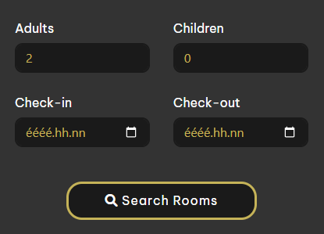
Provide your needs
Number of guests
Check-in date
Check-out date
Our search form

Slide 4

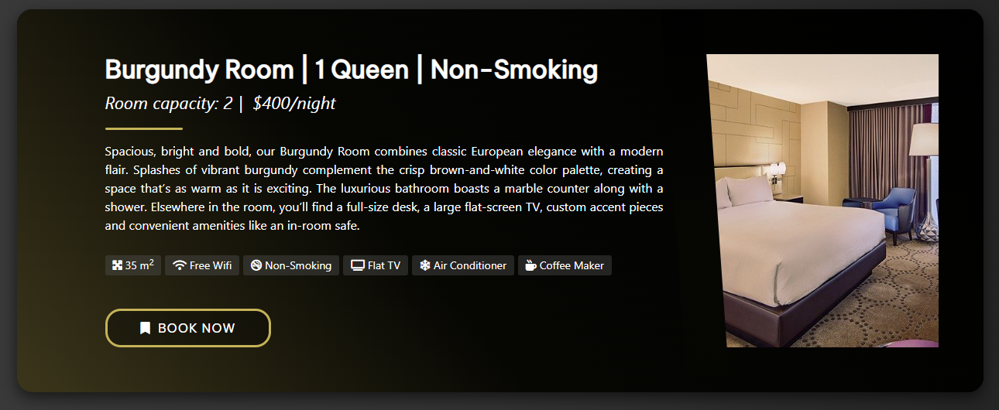
Pick a room
Suitable rooms
Room traits
Description
Images

Slide 5

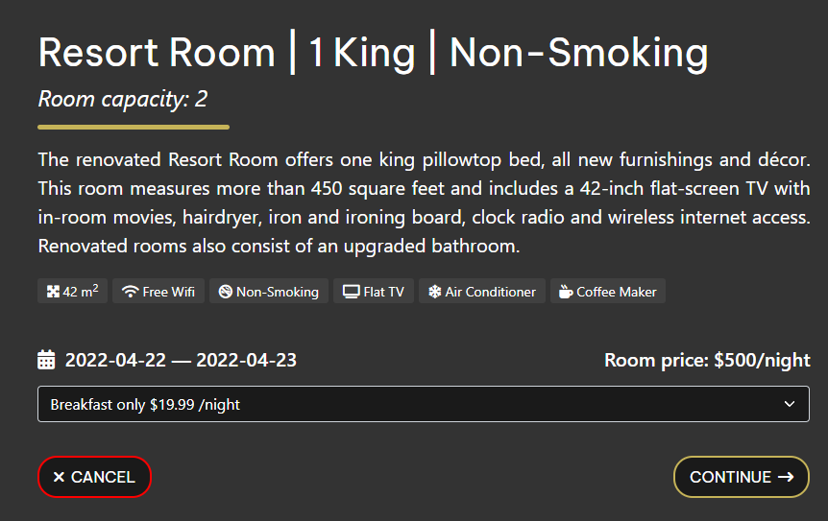
Room details Service type
More details
Pick a service type
Prices

Slide 6
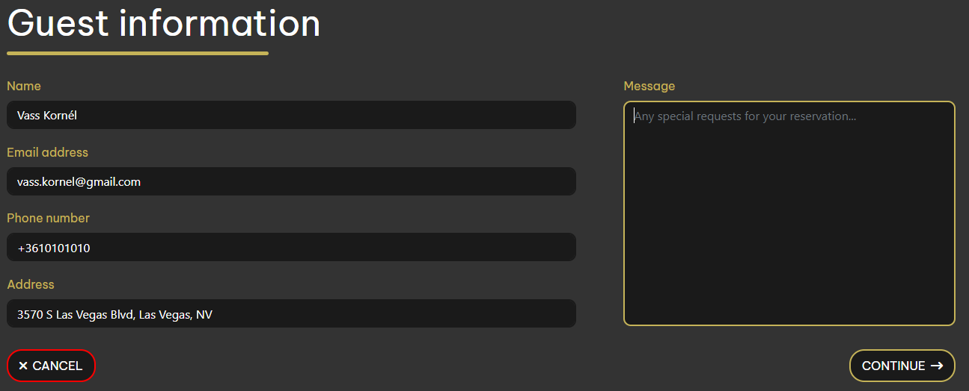
User informatins
Contact informations
Special requests

Slide 7
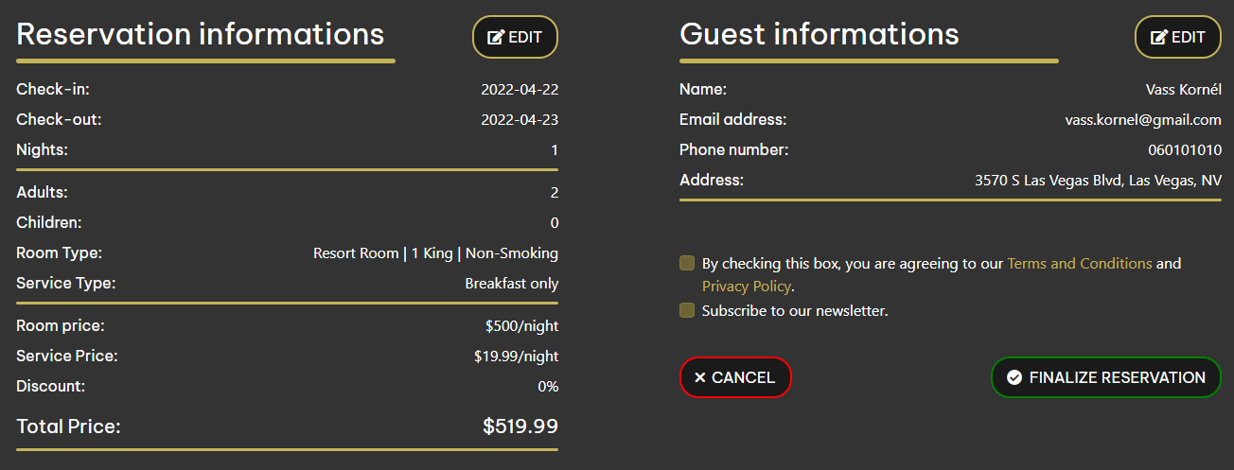
Summary
Edit wrong informations
Reveiw data
Accept TOS and Privacy Policy
Finalize reservation

Slide 8
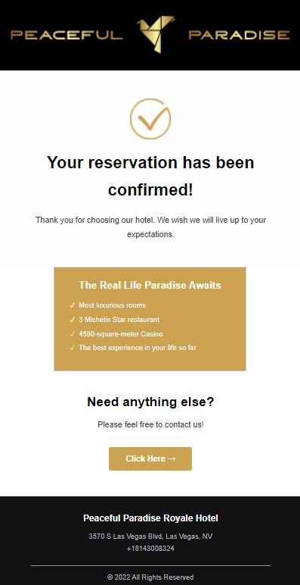
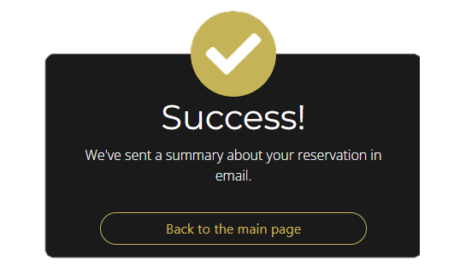
Check your email
Summary email

Slide 9

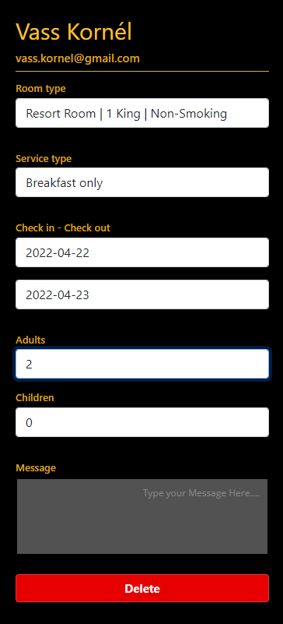
Check your reservations
All your previous reservation
Delete your upcoming reservation
Contact us for modifications

Slide 10

Login
Registration
Email or username
Password
Forgot password
Name
Email
Password
Confirmation

Slide 11




Our discount system
Gold
Platinum
Diamond
3 reservations
5% discount
6 reservations
10% discount
9 reservations
15% discount

Slide 12

Thank you for your time!
Made by:
Dávid Kálmán
Gábor Roncz
Kornél Vass

